Slide 1
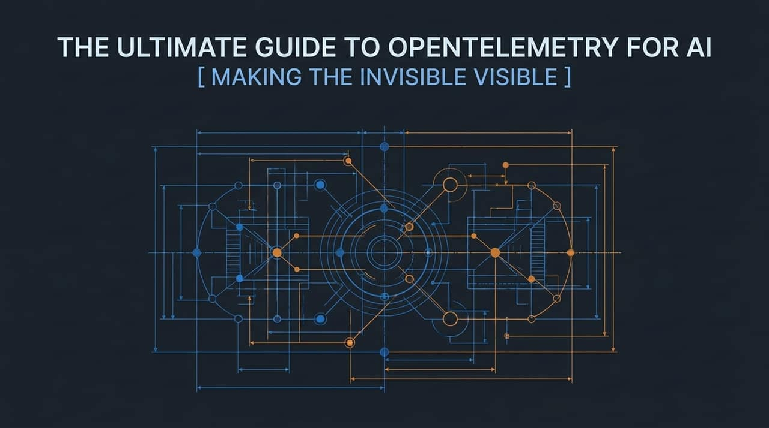
Notes:
Welcome, everyone. Today we are diving into 'The Ultimate Guide to OpenTelemetry for AI: Making the Invisible Visible'. As AI systems become central to software architectures—moving from simple static microservices to complex, non-deterministic agentic workflows—our observability practices must adapt. Standard infrastructure metrics like CPU utilization or HTTP status codes are no longer enough.
In this session, we will demystify AI observability. We will move step-by-step from foundational OpenTelemetry (OTel) principles to OpenInference standards, span hierarchies, sampling strategies, and production-ready implementation practices. By the end of this talk, you will understand how to turn invisible AI behaviors into actionable, traceable telemetry data.
https://www.youtube.com/watch?v=fHGSxOhWO-g

Slide 2
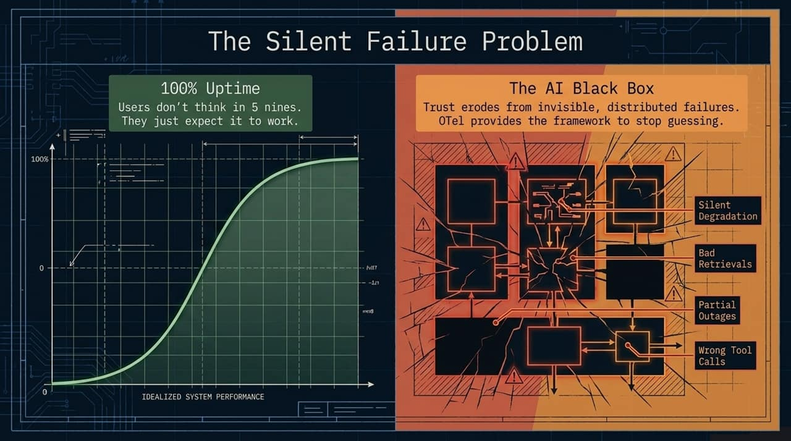
Notes:
To understand why AI observability is critical, let's look at The Silent Failure Problem. In traditional software engineering, an outage is usually explicit—a service returns an HTTP 500 Server Error, a database connection drops, or a pod crashes.
However, in AI applications, you can easily maintain 100% uptime on paper while your product is actively failing. Users don't think in 'five nines' of availability; they simply expect the system to provide correct, reliable results.
When an LLM application suffers from silent degradation, it might hallucinate facts, execute the wrong tool call, retrieve irrelevant chunks from a RAG vector database, or quietly produce truncated outputs. From the perspective of traditional monitoring tools, every HTTP call returned a 200 OK. But to the end user, the system is broken. This invisible breakdown erodes user trust rapidly. OpenTelemetry provides the standardized framework needed to stop guessing and start measuring what is actually happening inside the AI black box.

Slide 3
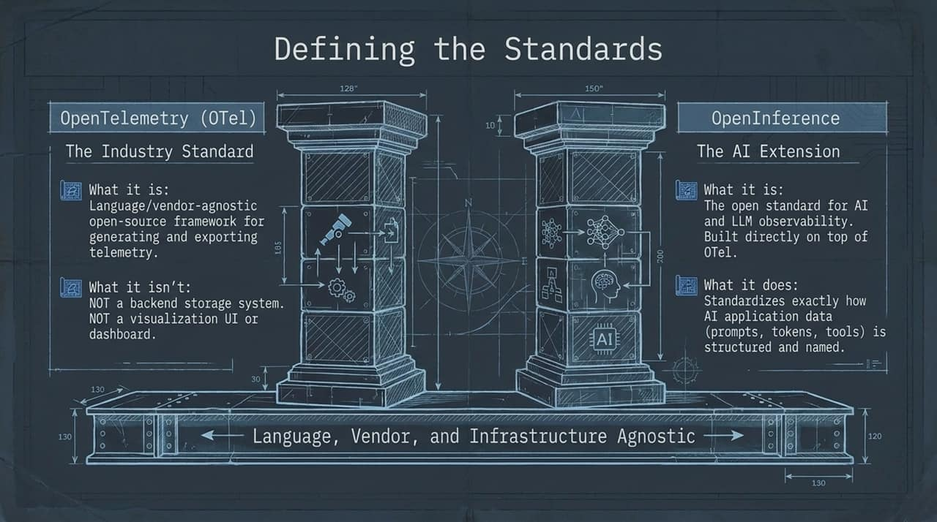
Notes:
To solve the black-box challenge, we rely on two key standards working together: OpenTelemetry (OTel) and OpenInference.
On the left pillar, we have OpenTelemetry. OTel is the CNCF industry standard. It is a vendor-neutral, language-agnostic framework designed to generate, collect, and export telemetry data—specifically traces, metrics, and logs. It is crucial to clarify what OTel is not: it is not a database, nor is it a dashboard or visualization tool. OTel handles the plumbing and transport layer.
On the right pillar, we have OpenInference. While OTel provides the base telemetry framework, it originally lacked semantic definitions for AI-specific concepts. OpenInference acts as the AI extension layer built directly on top of OTel. It standardizes how AI attributes—such as prompt messages, completion outputs, token usage counts, embedding vectors, and tool parameters—are named and structured.
Together, they ensure your AI telemetry remains completely open, portable, and independent of any single vendor backend.

Slide 4
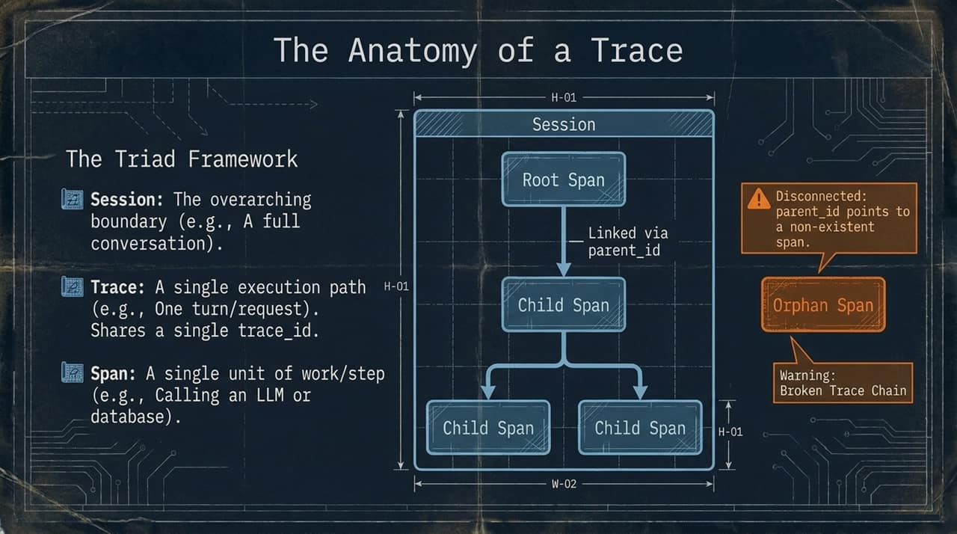
Notes:
Let's examine how telemetry data is structured using the Triad Framework: Sessions, Traces, and Spans.
Session: The highest boundary. A session represents an entire user journey or multi-turn interaction over time—such as a user chatting with a customer support bot over ten minutes.
Trace: A single execution path triggered by a specific request. For instance, one user prompt that causes an agent to run multiple steps forms a single trace shared across a unique trace_id.
Span: The fundamental building block. A span represents a single contiguous unit of work—like executing an embedding model, querying a vector store, or calling an LLM API.
Spans exist in parent-child relationships established through parent_id pointers. Pay close attention to the warning at the bottom of this slide: Orphan Spans. If context propagation fails or a parent_id points to a non-existent span, the trace chain breaks. In complex distributed AI workflows, broken trace chains make it impossible to reconstruct the execution tree.

Slide 5
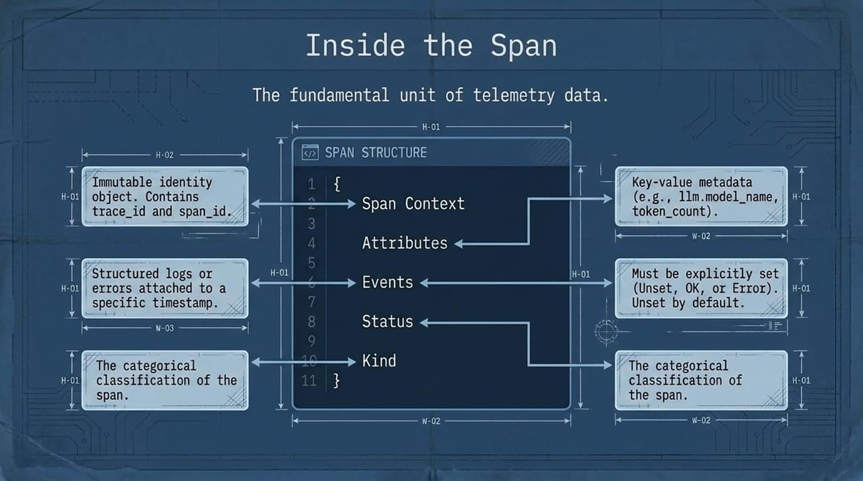
Notes:
Zooming inside an individual span, what key metadata does it contain?
Span Context: An immutable identity object holding the unique trace_id and span_id.
Attributes: Key-value pairs containing vital metadata. In AI applications, this is where token counts, model names, temperature settings, and prompt inputs/outputs live.
Events: Structured logs tied to specific timestamps within the duration of the span. These are great for marking discrete internal milestones, like stream token arrival.
Status: Explicitly defined state indicator—Unset, OK, or Error. Note that by default in OTel, status is Unset. If an exception occurs, you must explicitly set the status to Error so backend monitoring tools can flag it.
Kind: Classifies the role of the span (e.g., Client, Server, Internal).

Slide 6
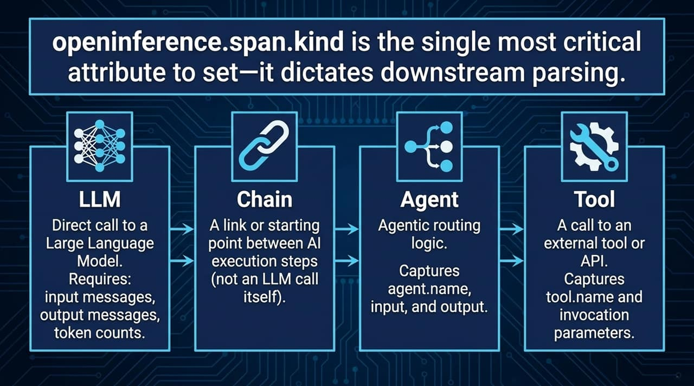
Notes:
Setting openinference.span.kind is arguably the single most critical task when instrumenting AI applications. Downstream observability backends rely heavily on this attribute to correctly parse and render your traces.
OpenInference defines four primary categories:
LLM: Represents a direct call to a language model. Requires capturing input messages, output completions, token counts, and model parameters.
Chain: Represents sequential execution logic or workflow orchestrations (like a LangChain execution path or custom pipeline).
Agent: Captures high-level agentic routing logic, decisions, and system prompts.
Tool: Represents an external API or function call executed by an agent—such as a database lookup, web search, or math calculator.
Categorizing spans properly allows downstream tools to separate model latency from external tool performance automatically.

Slide 7
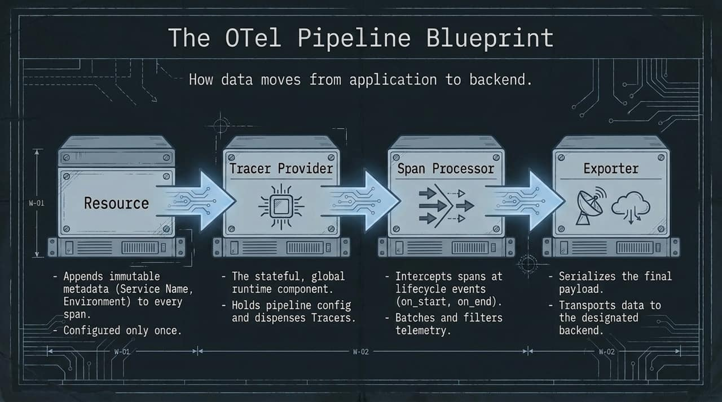
Notes:
Now that we understand how data is structured, let's look at how telemetry flows through your application using The OTel Pipeline Blueprint.
Resource: Configured once at startup. It appends immutable global metadata—such as service name, service version, environment (production vs staging), and host info—to every span generated.
Tracer Provider: The stateful runtime factory. It holds the global configuration and dispenses Tracer instances to your application modules.
Span Processor: Intercepts spans at lifecycle events (on_start, on_end). It determines how spans are processed, filtered, or batched before transmission.
Exporter: Converts in-memory spans into wire payloads and sends them to the destination backend.

Slide 8
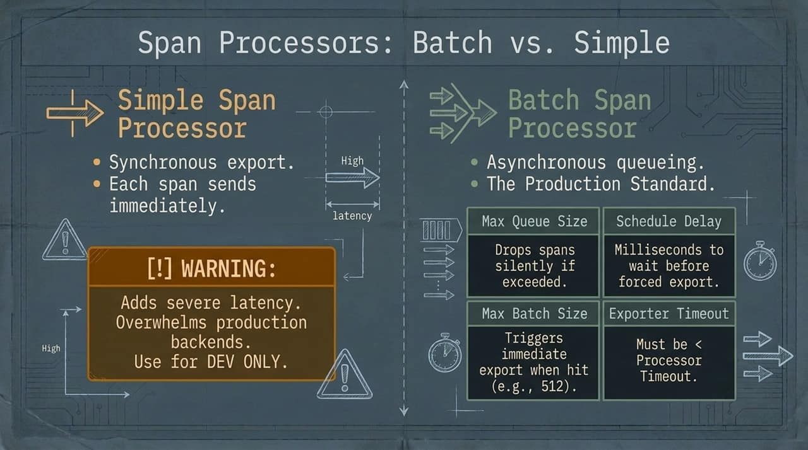
Notes:
When setting up your pipeline, you must choose a Span Processor. There are two choices, and choosing the wrong one will severely degrade your application's performance.
Simple Span Processor: Exports each span synchronously as soon as it ends. This adds massive network latency directly onto your application thread. Use this for local development and debugging only. Never run this in production!
Batch Span Processor: The mandatory production standard. It buffers spans asynchronously in memory and flushes them in batches based on configured thresholds:
Max Batch Size: Triggers an immediate export when reached (e.g., 512 spans).
Schedule Delay: Maximum time to wait before forcing a flush.
Max Queue Size: Caps memory usage; note that if exceeded, new spans are silently dropped.

Slide 9
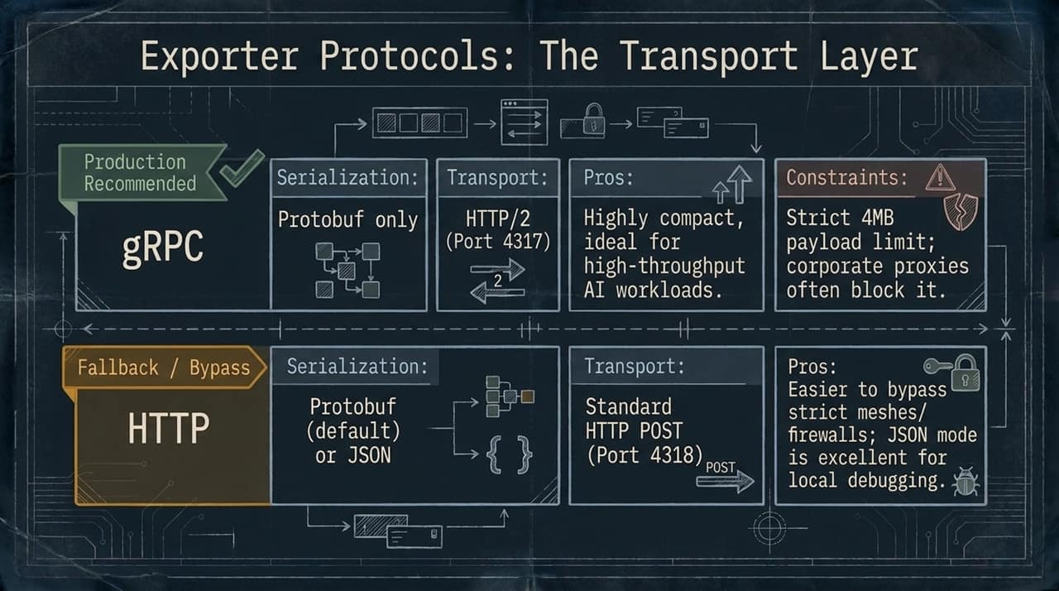
Notes:
Once spans are batched, how do they move across the network? We have two primary transport choices:
gRPC (Production Recommended):
Uses HTTP/2 on Port 4317 with Protobuf serialization.
Highly compact, multiplexed, and optimized for high-throughput AI workloads.
Constraints: Has a strict default 4MB payload limit, and corporate proxies or strict firewalls sometimes block gRPC.
HTTP (Fallback / Bypass):
Uses standard HTTP POST on Port 4318 with JSON or Protobuf serialization.
Ideal for local debugging and easily bypasses strict corporate firewalls or service meshes.

Slide 10
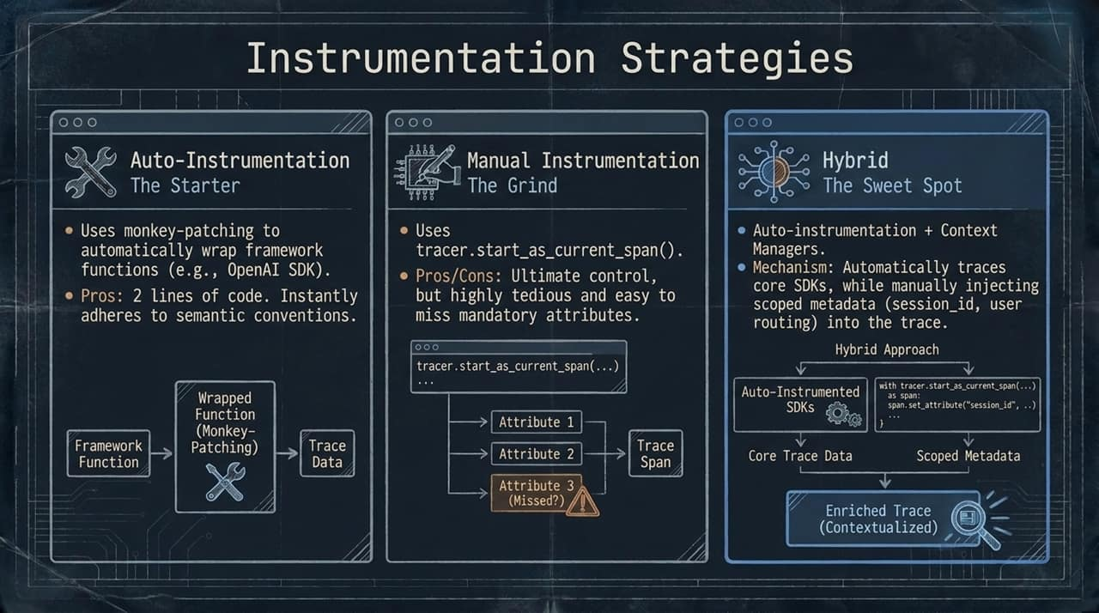
Notes:
How do we actually write the code to capture this telemetry? There are three main strategies:
Auto-Instrumentation: Uses monkey-patching under the hood to automatically intercept calls to popular libraries (like OpenAI, LangChain, or LlamaIndex). Requires almost no code changes, but gives you little control over contextual metadata.
Manual Instrumentation: Requires manually wrapping functions with tracer.start_as_current_span(). Provides complete control, but is tedious and error-prone.
The Hybrid Approach (The Sweet Spot): The recommended practice. You use auto-instrumentation to seamlessly capture standard LLM calls, while using context managers in your business logic to inject scoped metadata—like session_id, user_id, or routing flags—into active traces.

Slide 11
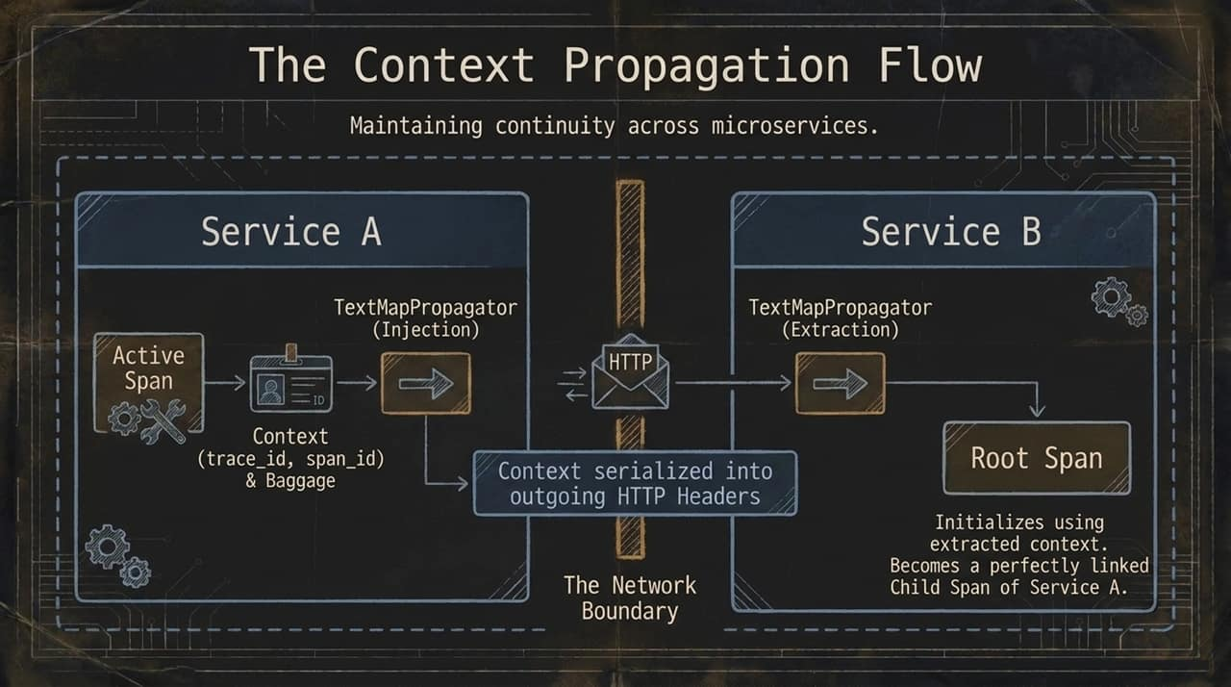
Notes:
In modern distributed architectures, an AI request often spans multiple microservices. How do we maintain trace continuity across service boundaries? Through Context Propagation.
When Service A makes an HTTP or gRPC call to Service B:
Service A uses a TextMapPropagator to inject the active span context (trace_id, span_id, and baggage) directly into outgoing HTTP headers (such as the W3C traceparent header).
Service B extracts these headers upon receiving the request.
Service B initializes its root span using the extracted parent context, seamlessly connecting Service B's operations as child spans of Service A.

Slide 12
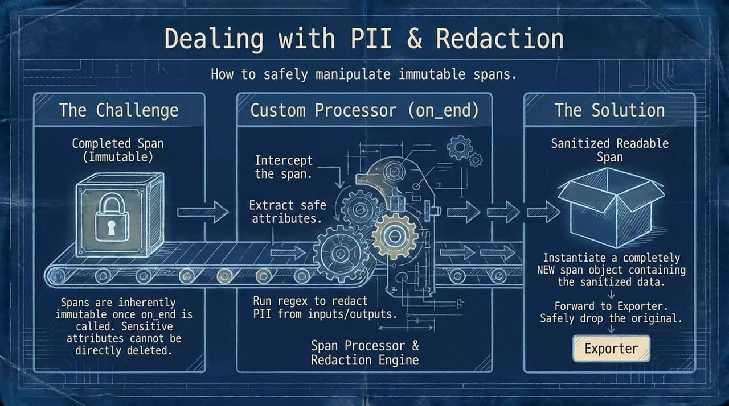
Notes:
AI inputs and outputs frequently contain sensitive user data or PII (Personally Identifiable Information). A key challenge in OpenTelemetry is that completed spans are immutable once on_end is called; you cannot simply modify or delete attributes on an existing span object in-place.
The Solution: Build a custom Span Processor Redaction Engine. When a span ends, the custom processor intercepts it before exporting. It extracts the raw attributes, applies regex/masking rules to sanitize sensitive prompts or outputs, instantiates a new sanitized span object, and forwards the clean span to the exporter while safely dropping the original.

Slide 13
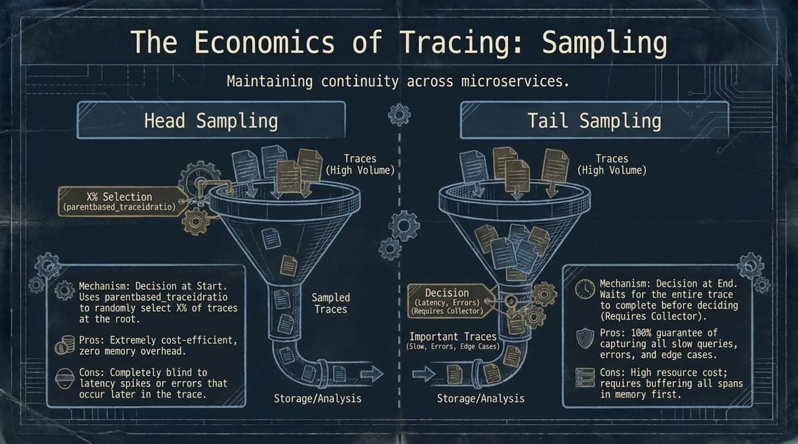
Notes:
At scale, collecting 100% of telemetry data can become prohibitively expensive. To manage cost and storage, we use Sampling.
Head Sampling:
Decision is made at the start of the trace.
Uses a ratio (e.g., sample 10% of requests).
Pros: Extremely cheap, zero memory buffer required.
Cons: Blind to errors or latency spikes that occur later during execution.
Tail Sampling:
Decision is made at the end of the trace.
Requires buffering spans in an OTel Collector until the full trace completes.
Pros: 100% effective at catching slow requests, errors, edge cases, and hallucinations.
Cons: Higher memory overhead on the collector infrastructure.

Slide 14
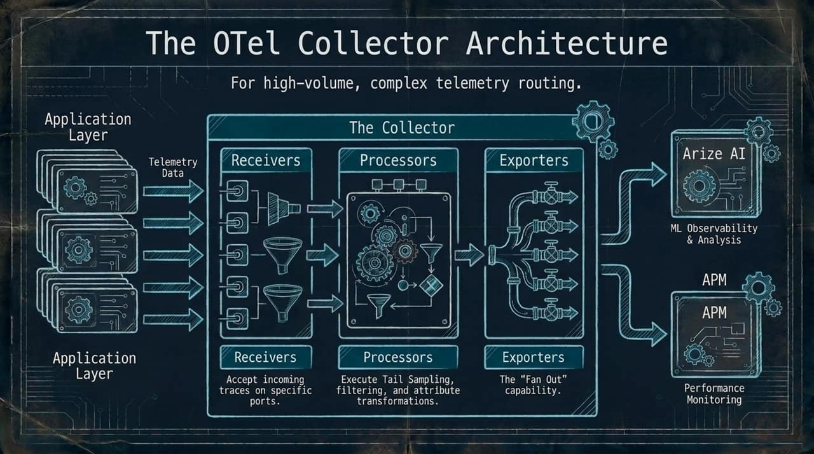
Notes:
For high-volume, enterprise production deployments, sending telemetry directly from application nodes to backends is anti-pattern. Instead, we deploy The OTel Collector.
The Collector consists of three sequential components:
Receivers: Accept incoming telemetry streams from applications on dedicated ports.
Processors: Execute heavy-duty tasks off-application thread—such as Tail Sampling, attribute scrub/transformation, and batching.
Exporters: Support 'Fan Out' capabilities, sending processed data concurrently to multiple destinations (e.g., Arize AI for ML evaluation alongside traditional APM tools for system performance).

Slide 15
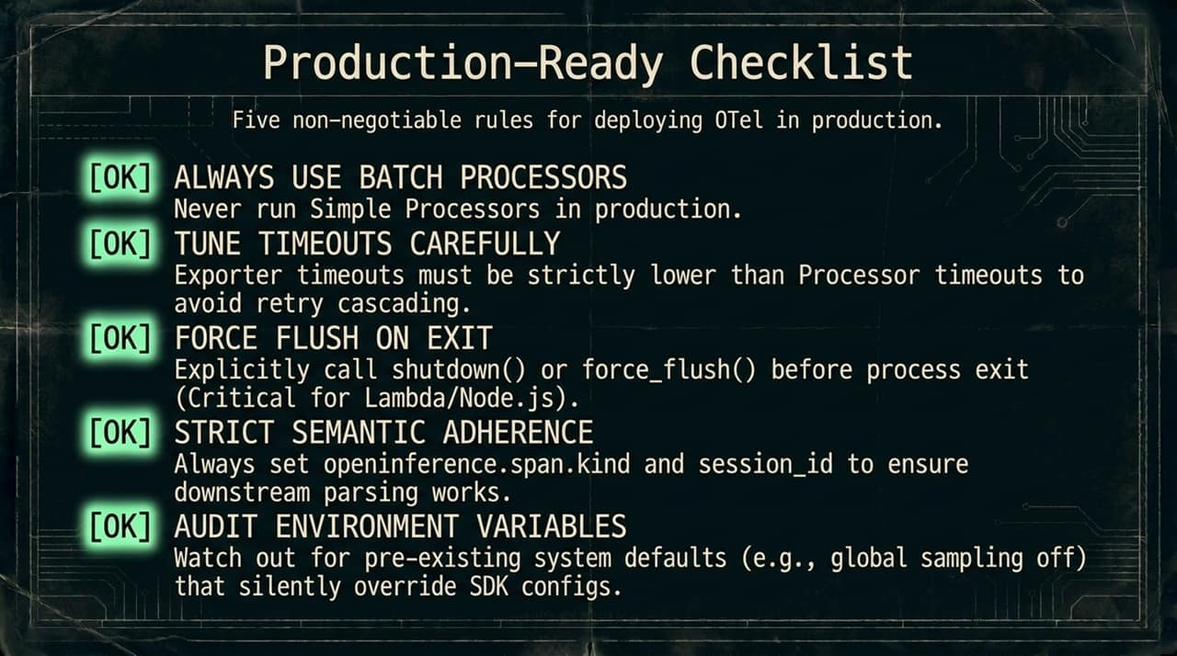
Notes:
Before shipping OpenTelemetry for AI to production, review these five non-negotiable rules:
Always Use Batch Processors: Never run Simple Processors in production to avoid severe latency degradation.
Tune Timeouts Carefully: Ensure exporter timeouts are strictly shorter than processor timeouts to prevent retry cascades.
Force Flush on Exit: Explicitly call force_flush() or shutdown() on process termination—critical for serverless environments like AWS Lambda or Node.js.
Strict Semantic Adherence: Always enforce standard naming, especially openinference.span.kind and session_id.
Audit Environment Variables: Watch out for pre-existing system env vars that might quietly override your SDK configurations in production.

Slide 16
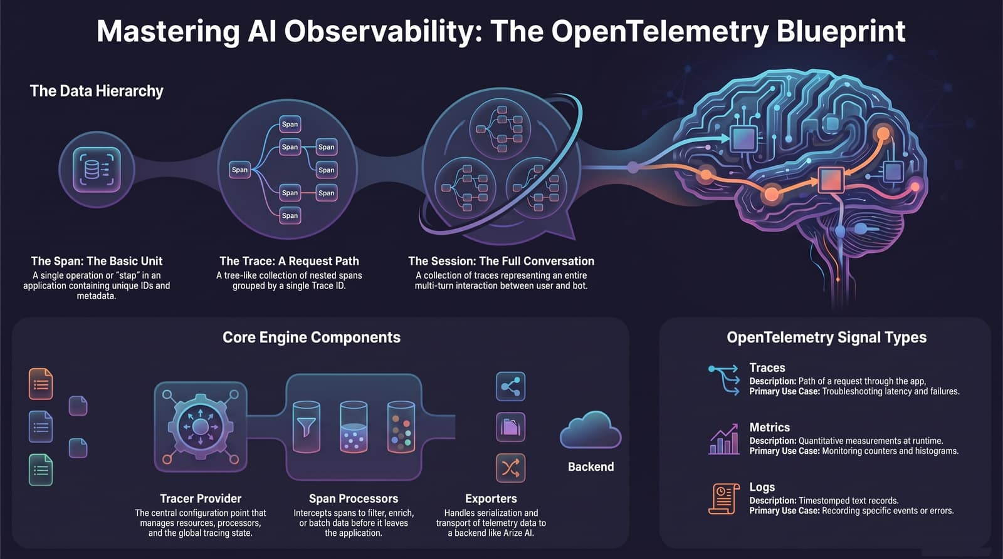
Notes:
To conclude our blueprint, let's summarize the key layers of mastering AI Observability:
Data Hierarchy: Remember how single operations (Spans) aggregate into full request paths (Traces), which roll up into complete user conversations (Sessions).
Core Engine: A well-tuned pipeline uses a robust Tracer Provider, asynchronous Span Processors, and efficient Exporters to move telemetry safely.
Signal Types: Combine Traces (for root-cause latency/failure analysis), Metrics (for token usage and cost monitoring), and Logs (for discrete event tracking).
By grounding your AI stack in OpenTelemetry and OpenInference standards, you turn silent failures into visible, actionable insights. Thank you!
https://www.youtube.com/watch?v=fHGSxOhWO-g

